Slide 1

Wellcome To Ethical Hacking class 4th Week Day 3rd
Muhammad Bilal

Slide 2
OpenVAS – Open Vulnerability Assessment System
Definition:
OpenVAS is an open-source vulnerability scanner used for identifying security issues in computer systems and networks. It’s part of the Greenbone Vulnerability Management (GVM) solution, offering a comprehensive way to detect and assess vulnerabilities.
Examples:
Example 1: A company uses OpenVAS to scan its internal network and finds several outdated software versions that are vulnerable to known exploits.
Example 2: An IT security team uses OpenVAS to regularly assess their infrastructure, identifying misconfigurations that could be exploited by attackers.

Slide 3
Operating System Detection
Techniques:
Regular Scans: Schedule routine scans to monitor your network’s security continuously.
Custom Scan Configurations: Customize scan configurations to focus on specific types of vulnerabilities or assets.
Tools/Websites:
OpenVAS Official Website: [Greenbone](https://www.greenbone.net/en/community-edition/)
Documentation and Tutorials: The [OpenVAS Documentation] (https://docs.greenbone.net/) offers detailed guidance on using the tool.

Slide 4
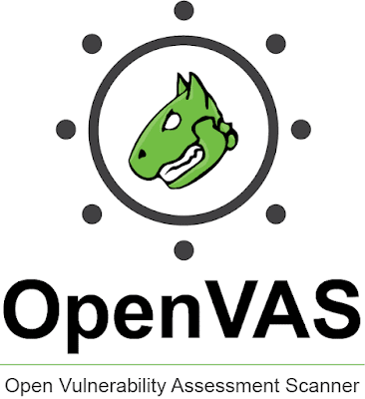
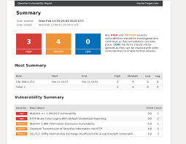

Slide 5
Nessus Vulnerability Scanner
Definition:
Nessus is a widely-used commercial vulnerability scanner developed by Tenable, Inc. It helps in detecting vulnerabilities, misconfigurations, and compliance issues in various systems, networks, and applications.
Examples:
Example 1: A healthcare organization uses Nessus to ensure its patient data servers are secure by identifying any vulnerabilities that could lead to data breaches.
Example 2: A financial institution uses Nessus to scan its online banking systems for security flaws, ensuring compliance with industry regulations.

Slide 6
Nessus Vulnerability Scanner
Techniques:
Automated Scanning: Set up automated scans to run at regular intervals for consistent security monitoring.
Integration with SIEM: Integrate Nessus with Security Information and Event Management (SIEM) systems to correlate vulnerability data with real-time threat intelligence.
Tools/Websites:
Nessus Official Website: [Tenable Nessus] (https://www.tenable.com/products/nessus)
Learning Resources: The [Tenable Community] (https://community.tenable.com/s/) provides tutorials, forums, and other learning resources.

Slide 7
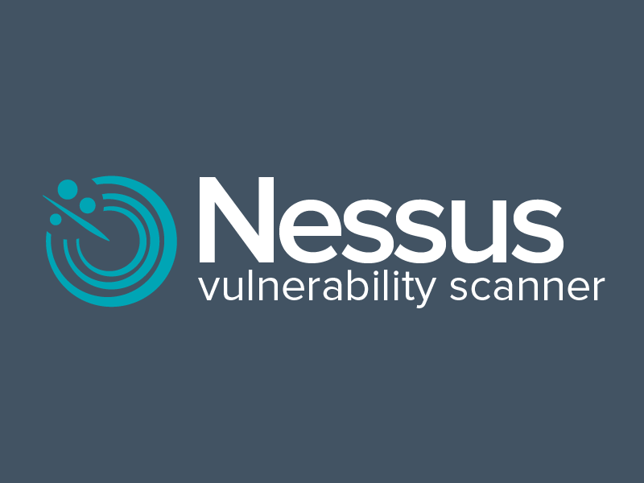
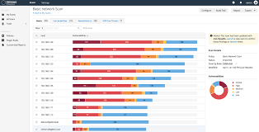

Slide 8
Qualys Vulnerability Management
Definition:
Qualys Vulnerability Management (VM) is a cloud-based service that helps organizations identify, classify, and manage vulnerabilities in their IT infrastructure. It provides continuous monitoring and real-time visibility into potential security risks.
Examples:
Example 1: A global enterprise uses Qualys VM to monitor its distributed network, receiving alerts when new vulnerabilities are discovered.
Example 2: A retail company uses Qualys VM to ensure its point-of-sale systems are secure and compliant with PCI DSS standards.

Slide 9
Qualys Vulnerability Management
Techniques and Tools:
Cloud Integration: Use Qualys VM's cloud capabilities to scan and monitor assets across different environments (on-premises, cloud, hybrid).
Asset Tagging: Organize and prioritize vulnerability management by tagging assets based on criticality, location, or function.
Tools/Websites:
Qualys Official Website: [Qualys Vulnerability Management] (https://www.qualys.com/apps/vulnerability-management/)
Training and Certifications: Qualys offers [training and certifications] (https://www.qualys.com/training/) to help users become proficient in using their platform.

Slide 10
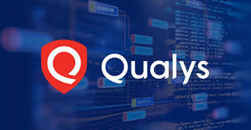
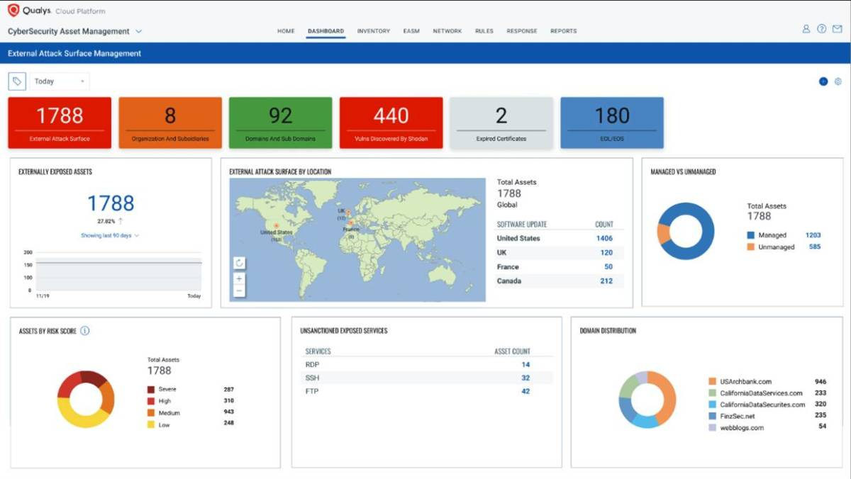

Slide 11
Vulnerability Assessment in Web Applications
Definition:
Vulnerability Assessment in Web Applications involves identifying, analyzing, and addressing security vulnerabilities within web applications. This process is crucial for protecting applications from attacks such as SQL injection, cross-site scripting (XSS), and more.
Examples:
Example 1: A company’s web application is tested for SQL injection vulnerabilities, and the assessment reveals several areas where an attacker could manipulate the database.
Example 2: During a routine assessment, a security team discovers cross-site scripting (XSS) vulnerabilities in a customer portal, which could allow attackers to inject malicious scripts.

Slide 12
Threat Intelligence Integration
Techniques and Tools:
Dynamic Application Security Testing (DAST): Use automated tools to scan running applications for vulnerabilities by simulating attacks.
Static Application Security Testing (SAST): Analyze source code or binaries to identify vulnerabilities without executing the application.
Tools/Websites:
Burp Suite: A popular tool for web application security testing.
OWASP ZAP: An open-source tool for finding vulnerabilities in web applications.

Slide 13
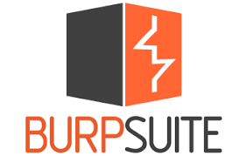


Slide 14
OWASP Top Ten Vulnerabilities
Definition:
The OWASP Top Ten is a standard awareness document that outlines the ten most critical security risks to web applications. It’s widely recognized as the foundation for developing secure web applications.
Examples:
Example 1: A development team uses the OWASP Top Ten as a checklist to ensure their new web application is secure against common threats like injection attacks.
Example 2: A security audit reveals that an organization’s application is vulnerable to Cross-Site Scripting (XSS), one of the OWASP Top Ten vulnerabilities.

Slide 15
OWASP Top Ten Vulnerabilities
Techniques:
Security by Design: Incorporate the OWASP Top Ten guidelines into the software development lifecycle (SDLC) from the beginning.
Regular Updates: Regularly review and update applications to protect against new vulnerabilities identified in the OWASP Top Ten.
Tools/Websites:
OWASP Official Website: [OWASP Top Ten](https://owasp.org/www-project-top-ten/)
OWASP Tools: Use tools like OWASP ZAP or OWASP Dependency-Check to detect vulnerabilities in web applications.

Slide 16
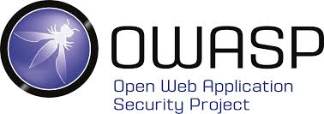
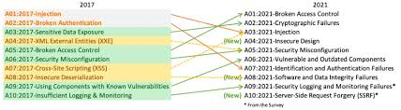

Slide 17
Happy Hacking

